Slide 1

Gradient Descent Eng/ Mahmoud Yasser Hammam

Slide 2
Section 1: Why gradient descent ??
- What is gradient descent, and why we need it??
- The gradient descent algorithm

Slide 3
Gradient descent: Theory and motivation
How deep learning models learn:
1- Guess a solution
2- Compute the error (mistakes)
3- Learn from mistakes and modify the parameters
So: we need a mathematical description of the error “landscape” of the problem, and we need a way to find the minimum of the landscape.

Slide 4
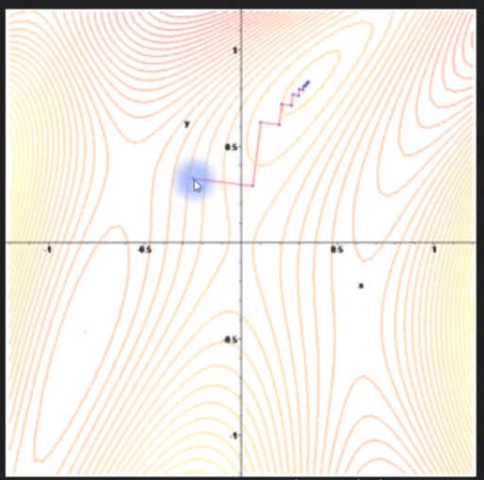
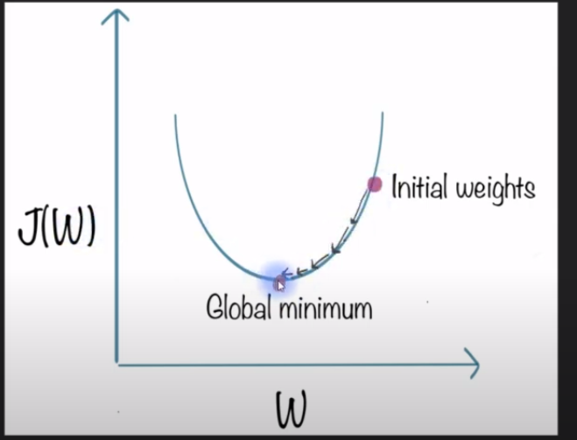
What is gradient descent?

Slide 5
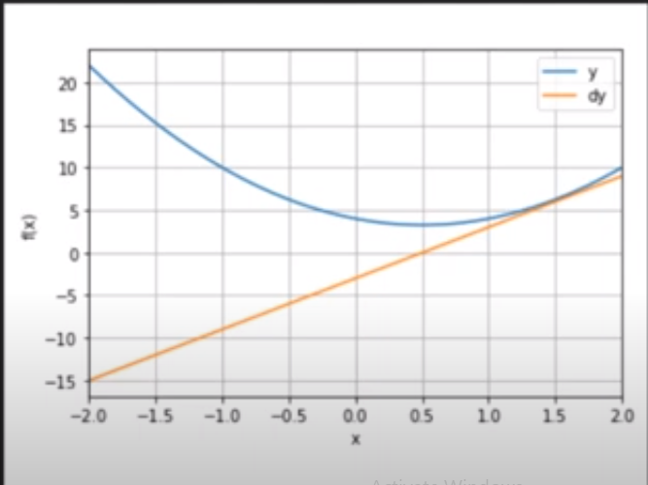
The function and its derivative
F(x) = 3x^2 – 3x + 4
Df/dx = 6x - 3

Slide 6
Gradient descent algorithm
Initialize random guess of minimum
Loop over training iterations
Computer derivative at guess min
Updated guess min is itself minus derivative scaled by learning rate

Slide 7
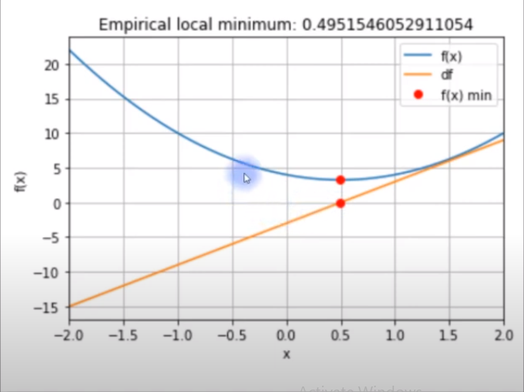
Gradient descent algorithm
Initialize random guess of minimum
Loop over training iterations
Computer derivative at guess min
Updated guess min is itself minus derivative scaled by learning rate

Slide 8
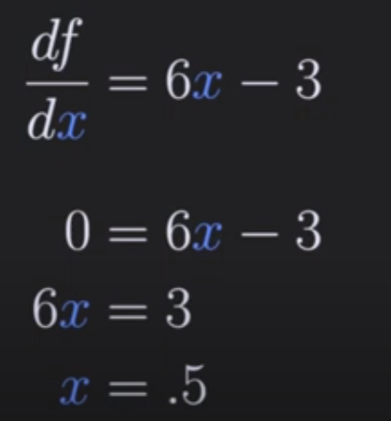
Gradient descent is wrong

Slide 9
Section 2: Local Minima
Gradient descent is guaranteed to go “downhill”
It is not guaranteed to find the correct – or even the best solution
Gradient descent can go wrong if parameters are not set right for the particular error landscape
Error Landscapes are impossible to visualize in >2D

Slide 10


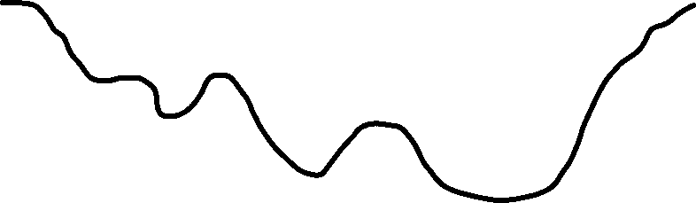

Local vs Global minima
Error landscape
Error landscape
Bad local minma
Good local minima
Global local minima

Slide 11
But does it matter?
The success of deep learning, in spit of the “problems” with gradient descent, remains a mystery.
It is possible that there are many good solutions (many equally good local minima). This interpretation is consistent with the huge diversity of weight configurations that produce similar model performance
Another possibility is that there are extremely few local minima in high-dimensional space. This interpretation is consistent with the complexity and absurd dimensionality of DL models

Slide 12
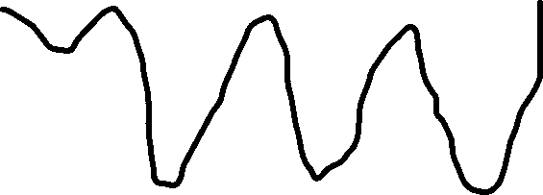




Local vs. global minima
Error Landscape
Bad local min
Equally good but distinct minima

Slide 13
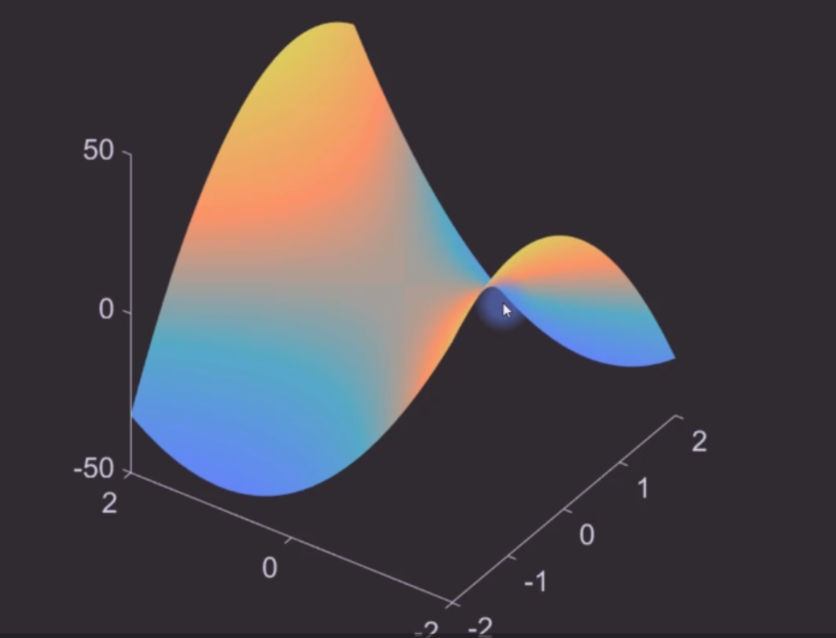


Or maybe there aren’t so many local minima
Saddle point
Local min in one direction
Local max in other direction

Slide 14


Or maybe there aren’t so many local minima
Saddle point
Local min in one direction
Local max in other direction
G.D. will get trapped in a local minimum only if that point is a minimum in all dimensions
In an extremely high-D space, there might be few local minima

Slide 15
What to do about it
When model performance is good, don’t worry about local minima.
One possible solution: Retrain the model many times using different random weights( different starting locations on the loss landscape) and pick the model that does best.
Another possible solutions: Increase the dimensionality (complexity) of the model to have fewer local minima

Slide 16
Section 4: Gradient descent in 1D
1- Seeing how gradient descent is implemented in code
2- Learn how two important parameters (learning rate and teaching epochs are implemented)
3- Appreciate why gradient descent is not guaranteed to give the correct answer

Slide 17
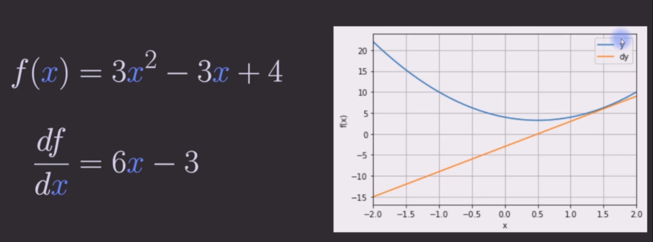
The function and its derivative

Slide 18
Practical

Slide 19
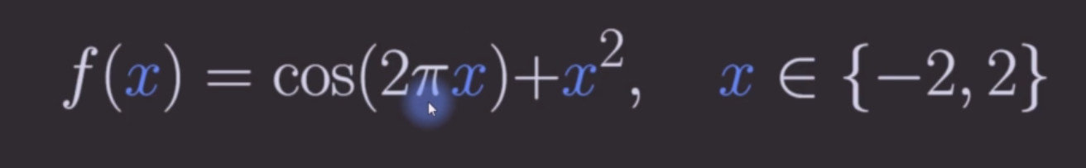
Section 5: code challenge (Assignment)
Step 1: Repeat 1D g.d. to find minimum of the following function:
Step 2: Hard code a starting value of x =0

